Slide 1
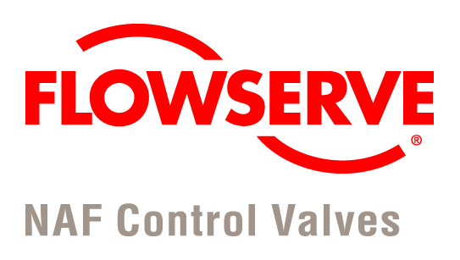
SP1-S-1.1

Slide 2

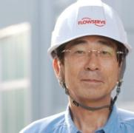
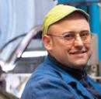
Flowserve at a Glance
Leading manufacturer and aftermarket service provider of comprehensive flow control systems
Turnover approximately 5 billion USD
Portfolio includes pumps, valves, seals, automation and aftermarket services
Focused on oil & gas, power, chemical, water and general industries
Worldwide presence with approximately 16,500 employees
65 manufacturing facilities and 175 aftermarket Quick Response Centers (QRCs) with employees in more than 50 countries

Slide 3







The Flowserve Legacy
Powerful legacy of more than 200 years of industry leadership with a respected roster of established brand names known worldwide
NAF
Wilson-Snyder Acquired
Anchor-Darling Valves Acquired
Durametallic Corp. Acquired
ACEC Pump – Belgium Acquired
Flowserve AS Lokeren, ZAR Bheer, and BTR
1790 - 1995
Flowserve Formed
Duriron Becomes Durco International
Stork Engineered Pumps Acquired
2004
1997
2000
2002
2005
2009
2010
2011
Flowserve Acquires IDP
Flowserve Acquires Invatech and Eccon
Flowserve Acquires Invensys Flow Control
Flowserve Acquires Thompson Kelly & Lewis
Flowserve Acquires Interseal
Flowserve Acquires CALDER™ AG
Flowserve Acquires Valbart Srl
Flowserve Acquires Lawrence Pumps, Inc.
Automax Acquired
BWIP Formed
Valtek Acquired
Borg Warder Acquired Jackson
Durfron Storck Publicly Traded
Durable Iron Invented
Byron Jackson Founded
Simpson & Thomson

Slide 4
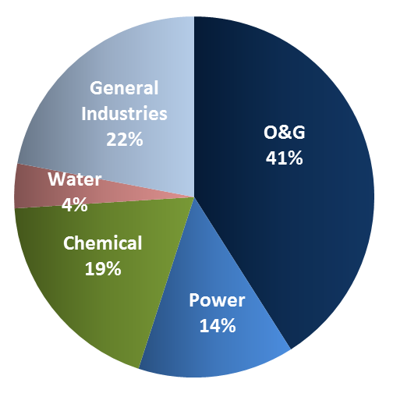
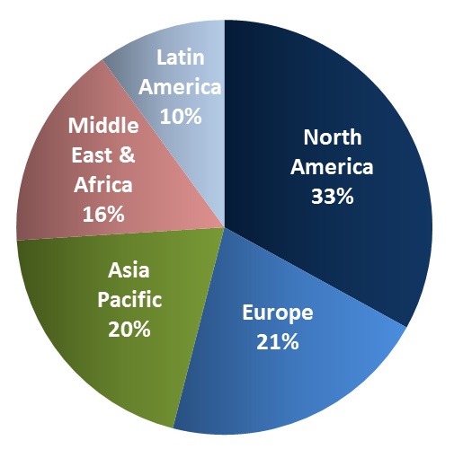
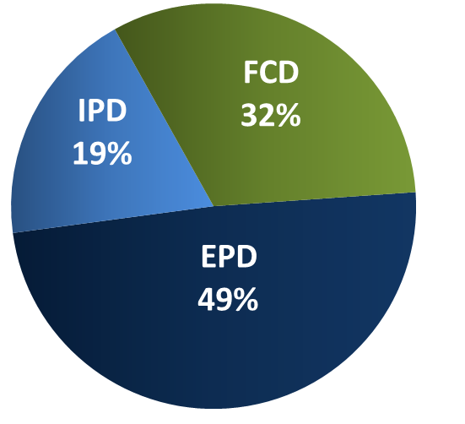
Balanced Portfolio Providing
Diversification
  Flowserve has a diverse mix of products serving many markets and geographies providing earning stability and a decreased overall risk profile of the company
  Operating Segments
  Engineered Products Division (EPD) - highly-engineered pumps and seals
  Industrial Products Division (IPD) - pre-configured pumps and systems
  Flow Control Division (FCD) - industrial valves and automation solutions
  Diverse Markets
  Geographic Diversification
Sales Mix

Slide 5

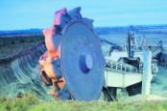

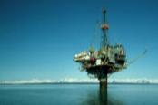

2013 FCD bookings: $1.66 B
Flow Control Division (FCD)
Chemical
General Industries
Power
Oil & Gas
Water
Bookings by Region
¼-turn ball, plug, and butterfly valves designed for isolation of highly corrosive, erosive, or lethal processes
Pneumatic valve actuation and automation solutions
¼-turn ball, check, gate and butterfly valves designed for isolation and control of slurry services
Linear control valves for low-flow and cryogenic applications
Multi-turn gate, globe, and check valves for high temperature and high pressure steam services
Thermostatic steam traps and electronic controls for high efficiency boilers
Heavy-duty electric actuators and controllers for valve automation
Linear and rotary control valves for general service and severe applications involving high pressure drops, cavitating or flashing services, or extreme temperatures
Trunnion-mounted ball valves for gaseous and liquid services
Lubricated plug valves for zero-leakage applications
Multi-turn and ¼-turn non-intrusive electric actuators for isolating and modulating services
Sleeveless, non-lubricated plug valves for isolation services requiring tight shut-off and in-line repairability
High performance, double-offset butterfly valves for isolation services
Bookings by Industry
Products - FCD provides highly-engineered and pre-configured valves
Industries – Bookings balanced across oil & gas, chemical, power, and GI
Regions - Driven by large global capital projects and local aftermarket solutions

Slide 6
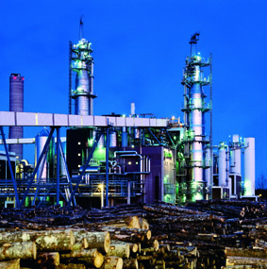
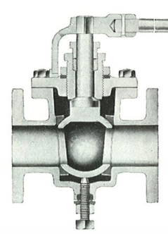
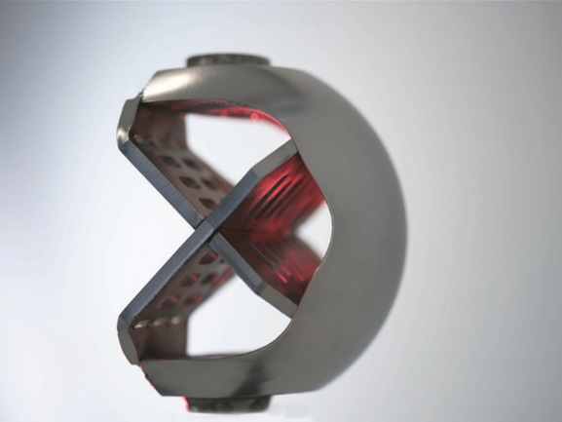
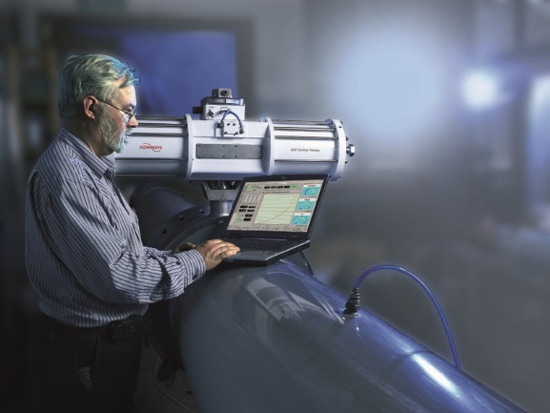
NAF at a Glance
Valve supplier to the industry since 1899
Made the first ball valve in the world in 1933
Head office in Linköping, Sweden
R&D, Sales, Manufacturing, QRC
Focus on automated rotary on-off and control valves
Global customer base
Flexible supplier in a strong focused and combined group
Part of Flowserve since 2002

Slide 7
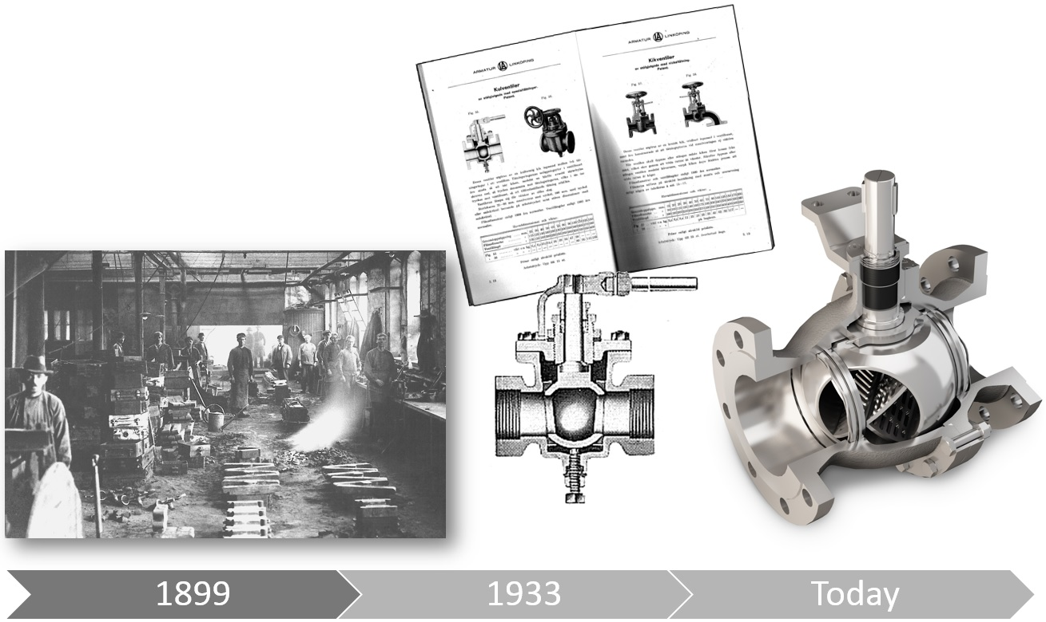
Flowserve NAF History
NAF started its operations as long ago as 1899
In 1904 the Company delivered its first stainless steel valves to the process industry
In 1933 we presented the first ball valve in the world
Today we are a leading brand to Pulp&Paper industry globally

Slide 8
NAF Business Market Position
Leading brand in Pulp & Paper globally
Global sales channels
Product range to supply green field projects (P&P)
Competence and long experience to supply rotary control valve applications
Localized main products in China for local market
Growth opportunity in the Chemical/Petrochem industry
Revenue approx. 200 MSEK
(22 MUSD)
  Industry Breakdown
  Geographic Diversification
Sales Mix
P&P
81%

Slide 9
NAF Organization
Plant Manager
Martin Feuk
HR
Anita Hedling
Product Manager
Per
Lundqvist
IT
Marcus Peterson
R&D/
Engineering
Axel Danielsson
Quality/
Purchasing
Mats Sandberg
Manufacturing
Håkan Ögren
Commercial
Operations
Gert-Jan Pol
Sales
Martin Humphrey
Finance/ Admin
Karin Jensen
Total headcount: 57

Slide 10
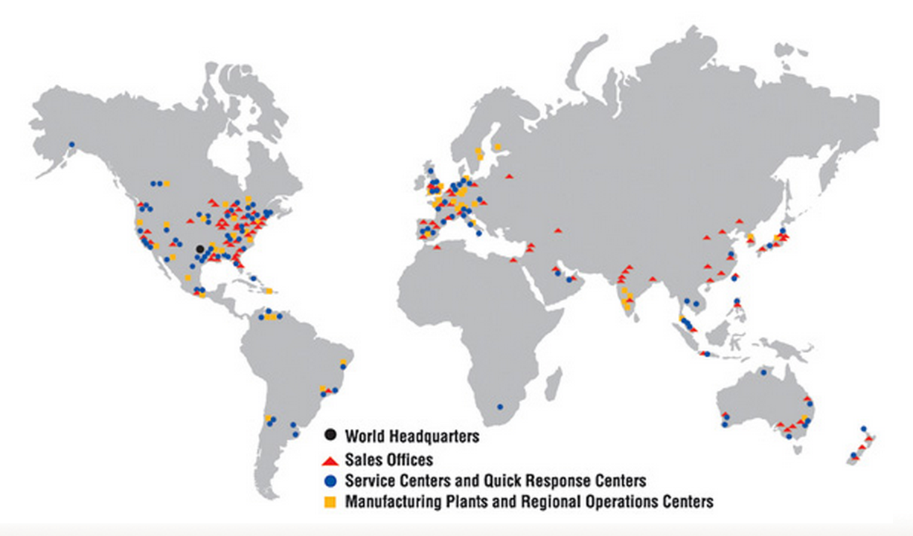

Global Presence
NAF Head Office:
Linköping, Sweden
R&D, Sales, Mfg, Automation, QRC
Suzhou, China
Mfg, Automation, QRC
Três Lagoas, Brazil
QRC
NAF sells to representatives and distributors in >30 countries

Slide 11

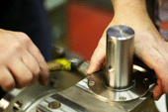
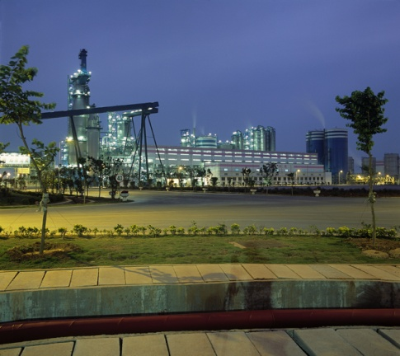
NAF Quality
"NAF shall develop, produce and market valves for the process industry, with a quality that meet our customers expectations and demands through continuous improvements."
Product quality
Product selection
Delivery performance
Documentation
Project management

Slide 12
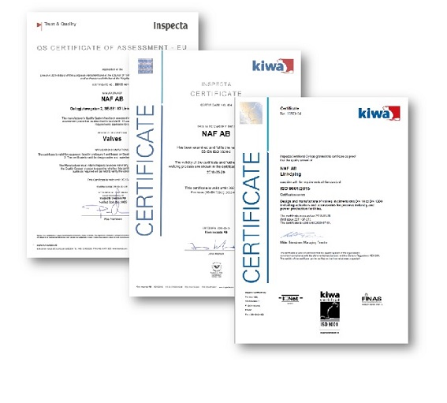
Quality system
ISO 9001:2015
PED, Module H and H1,CE mark
SS-EN ISO 3834-2
SP1-S-1.9
Notes:
ISO 9001
Describes our general Quality Assurance system with regard to the design, manufacturing and marketing of valves.
We have been certified by Det Norske Veritas since 1994.
PED/CE
NAF was the first Swedish valve manufacturer to be certified for module H and H1 (PED) in 2002.
This means that we have the right to CE-mark our valves for the most demanding applications. Our Notified Body is Det Norske Veritas.
SS-EN-729-2
To guarantee optimal quality on our welding process we have fully implemented the EN-729-2 standard.
The system is externally certified by Det Norske Veritas.

Slide 13
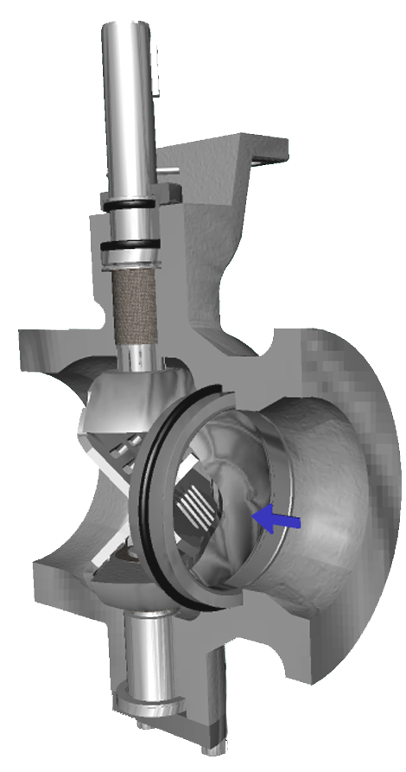
State of the art technology
Material selection
Noise and anti cavitation solutions
Diagnostic tools
Communication
Control performance
More than 100 years of product development
with customer applications in focus

Slide 14
Application Knowledge
  Selecting the correct flow control solution requires in-depth application know-how.
  We need to understand not only the valves, but also the process, its conditions and the special demands the process places on the valve.
  Our long experience in the Pulp & Paper industry is reflected in our control valve package, where all components are optimised to work together in your process.
Accuracy at Basis Weight
Impurities and particles
Pressure shock around digesters
Extreme sequences
Green Liquor crystallisations
High pressure drops
Erosive media
Black Liquor with high dry solids
Capping valve applications
Corrosive media

Slide 15
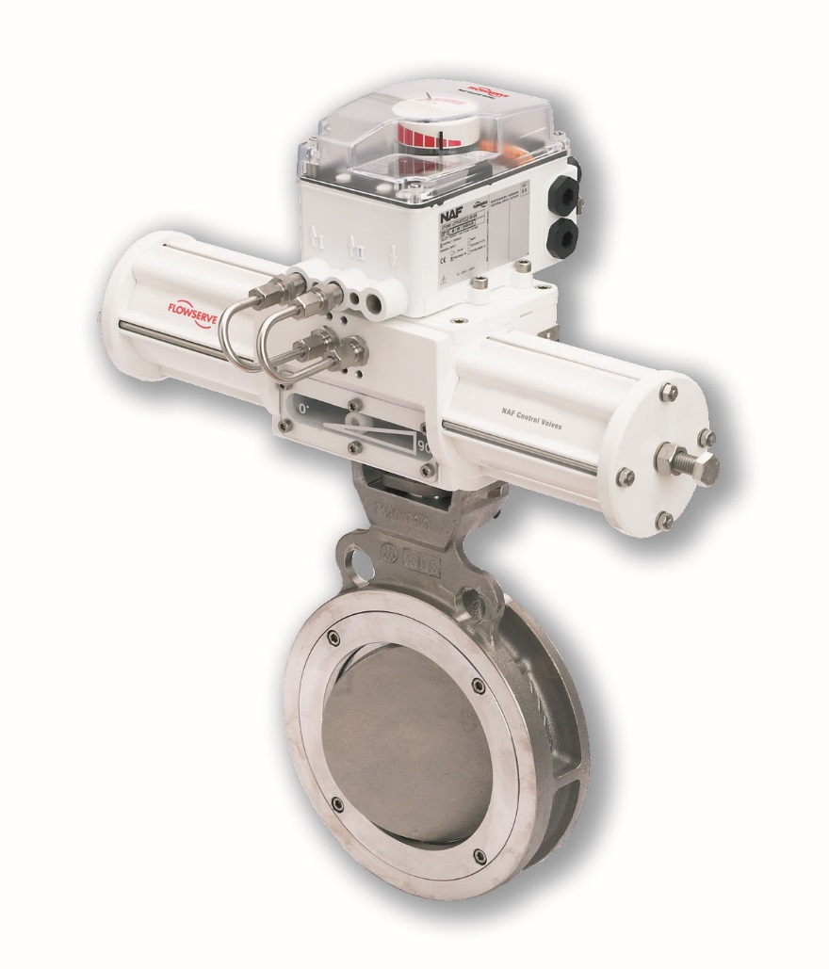
The NAF Concept
  When you understand that every hour of downtime in a plant can cost 100,000’nds of USD, you understand the need for a reliable product.
In developing our products our core values are modular thinking, flexible design and ease of service. Our compact design, with no brackets or couplings, and maintenance-free stem seal, are a few examples of standard features of our core products
Positioners
Compact mounting
Modular thinking
Service friendliness

Slide 16
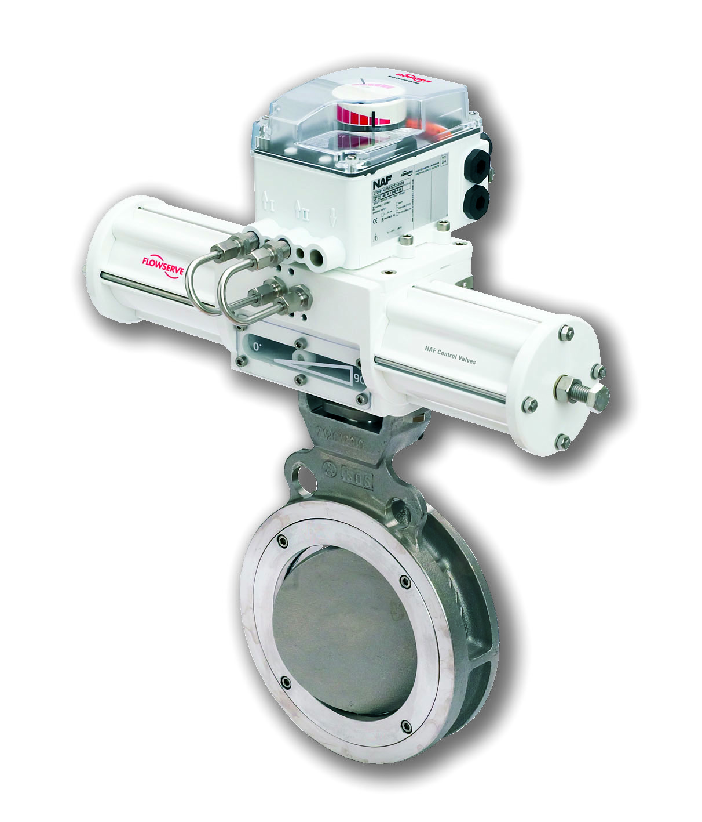
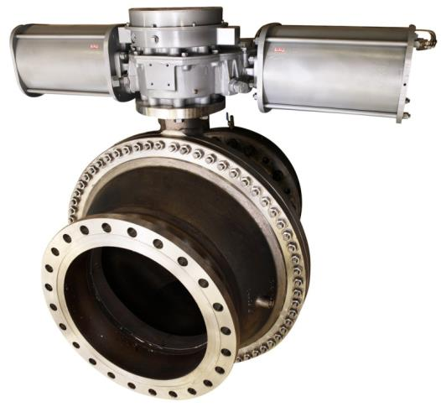
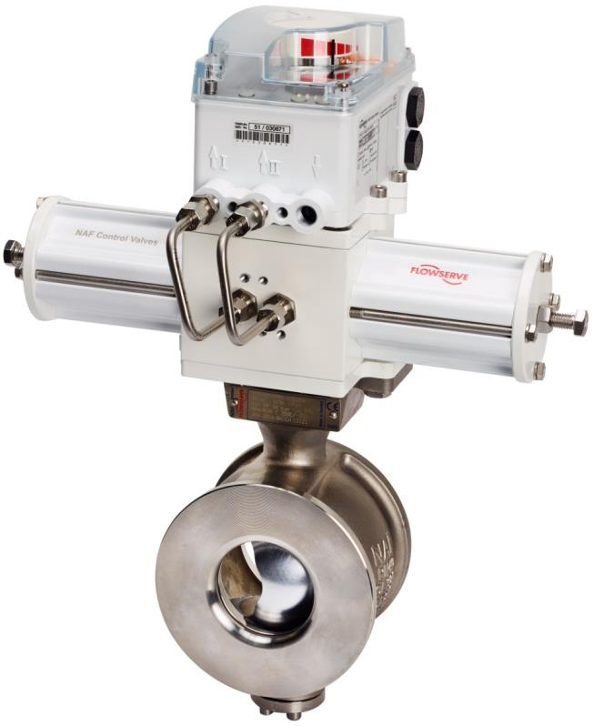
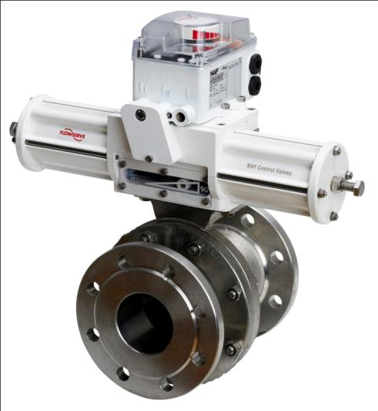
NAF Control and On/Off Valves
NAF Trunnball DL
High performance, trunnion mounted ball valve
DN150/6”-DN900/36”
PN10-PN40/ANSI Class 150 and 300
Versions: Z-trim, Fire-Safe
NAF Torex
High performance, triple offset butterfly valve
DN 80/3”-DN700/28”
PN10-PN40/ANSI Class 150 and 300
NAF Setball
High performance, ball sector valve with V-port
DN25/1”-DN700/28”
PN10-PN40/ANSI Class 150 and 300
Versions: Wafer, flanged, SF and MC version
NAF Duball DL
High performance, floating ball valve.
DN25/1”-DN400/16”
PN10-PN40/ANSI Class 150 and 300
Versions: Pocket, Z-trim, Ceramic, Fire-Safe, High Temp,

Slide 17
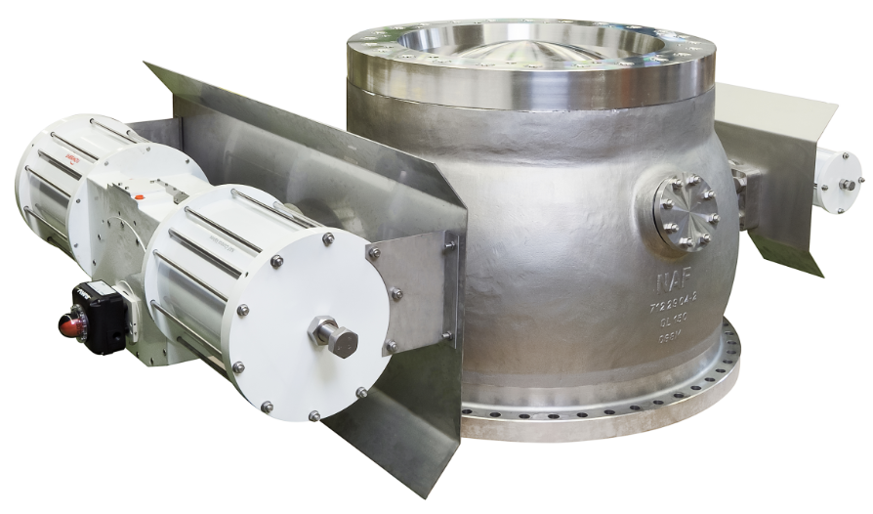
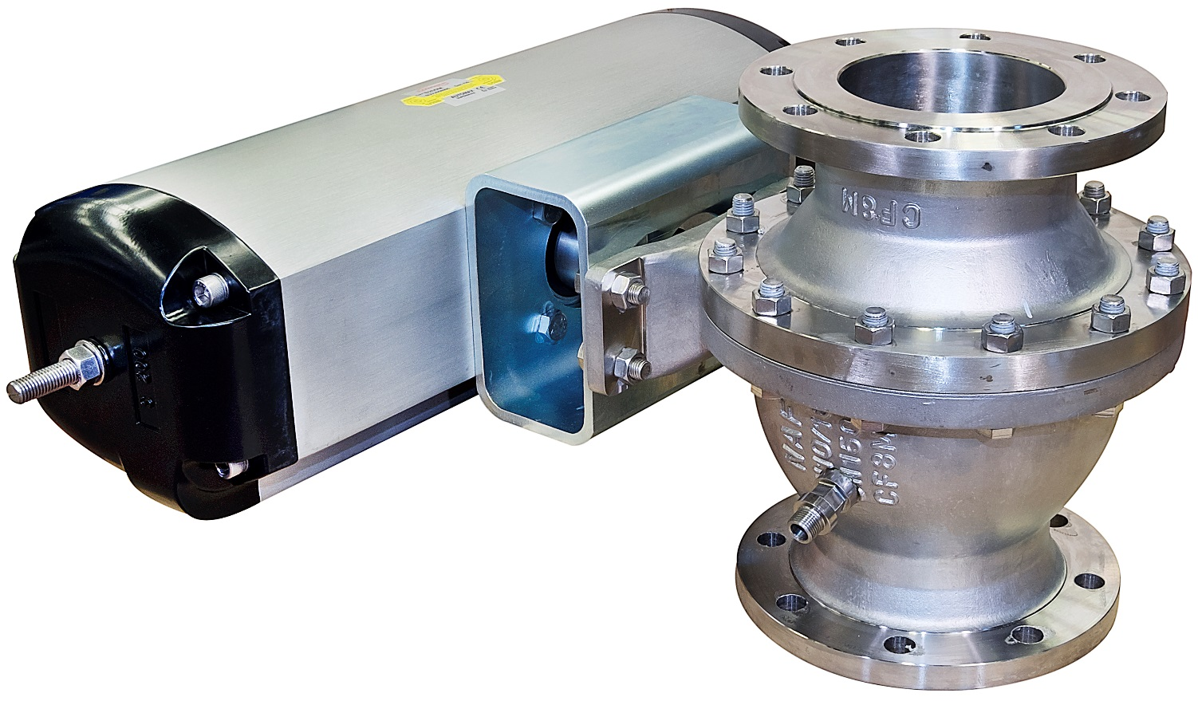
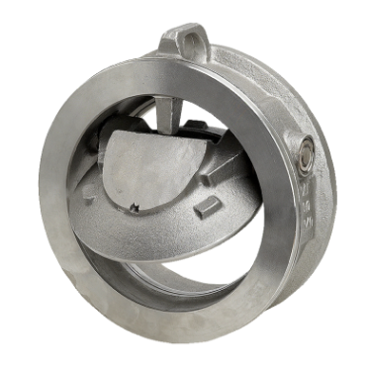
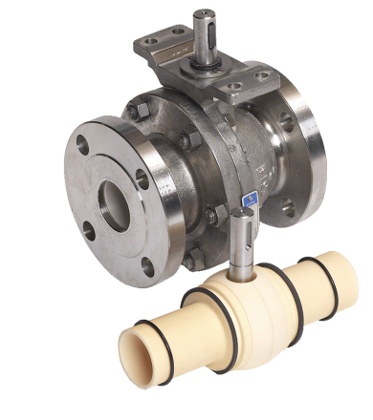
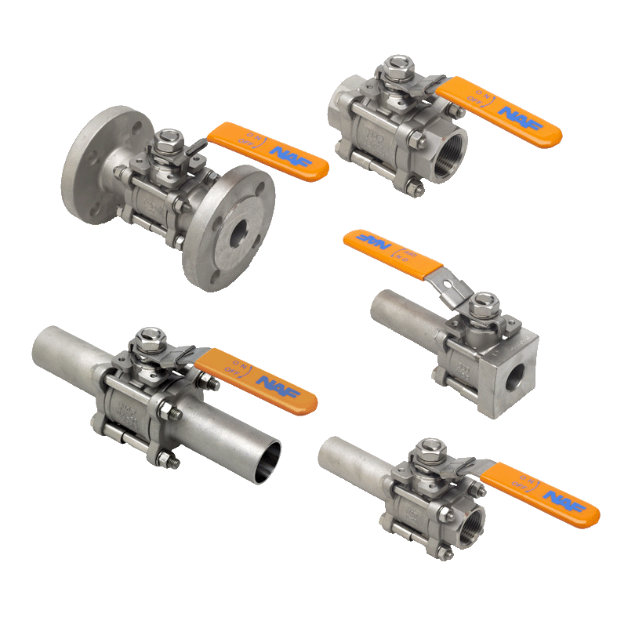
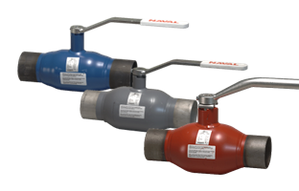
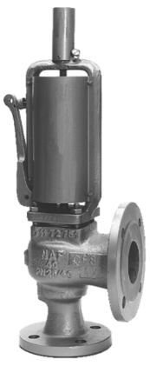
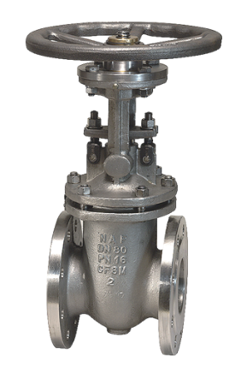
NAF Special Valves and more
NAF ProCap
NAF Duball DL Pocket
NAF Check
NAF Duball DL Ceramic
NAF Gate valves
NAF Triball
Navalball
NAF Safety valves

Slide 18


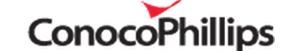
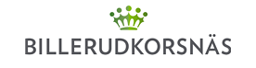






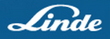



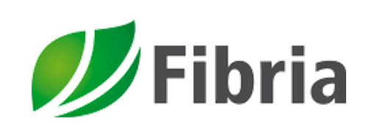




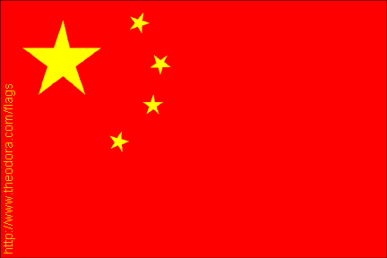





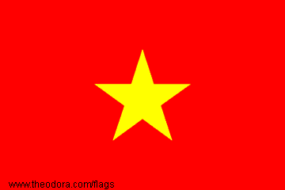













Andritz
APP
Assi Domän
BillerudKorsnäs
CIA Suzano
ConocoPhillips
Eldorado
Fanapel
Fibria
Hansol Paper
Holmen
Langerbrugge
Ledesma
Lignotech
Linde
M-Real
Metso Fiber
Preem
Sappi Gratkorn
Sappi Saiccor
SCA
Smurfit Munksjö
Stora Enso
Södra Cell
VCP
References

Slide 19

END OF PRESENTATION -
Thanks for listening

