Slide 1
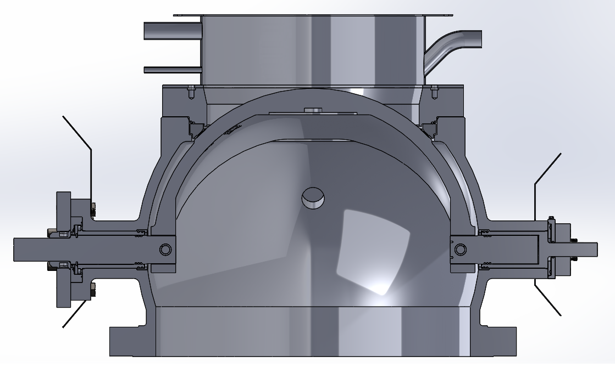
NAF ProCap Water Mirror concept
2017-06-19

Slide 2
What is a ”capping valve water mirror”?
A water mirror is a top mounted add-on to a capping valve
A continuous flow of water fills an area on top of the ball sector, creating a “mirror”
This reduces the risk of damage to the sealing area as wood chips/debris that could have gotten stock to the ball sector fall into the water
It also traps gases and cooking chemicals
This prolongs the lifetime of the capping valve and minimizes risk of leakage

Slide 3
Water mirror concept and basic features
There are (at least) three connections to the water mirror:
The water supply, providing a constant water flow to the unit. This connection is to be at least DN15 (size ½”)
The water outflow. This outlet is preferably equipped with a water lock to avoid chips following the water flow. This connection is to be at least DN50 (size 2”)
A gas evacuation pipe, to trap possible gas leakage. This is to be connected to an evacuation fan. This connection is to be at least DN50 (size 2”)
3
2
1

Slide 4
Water mirror concept and basic features
The water mirror can be single walled or double walled:
A double wall concept is based on the theory that gases are trapped in the double wall compartment
A double walled water mirror is more complex in its construction with more inlets, outlets and walls required
The inner wall also reduces the capacity of the valve
Furthermore, inspection of possible leakage as well as cleaning/maintenance in significantly harder with a double wall construction. Chips easily block the compartment and reduces functionality of the unit.
Single walled units are more simple in their construction but require a closed compartment above the water surface to be vented

Slide 5
Why should you use a water mirror?
After chips have filled the digester and cooking has been initiated, additional wood chips could fall down onto the ball sector
As the sector is quite hot and chemicals from the process could be present, there is a high risk that chips start to burn onto the surface
Stuck objects could damage the sealing area during operation of the ball sector (and, after operation of the valve creates an “asphalt highway”)
Having a water mirror, this can be avoided as chips fall into the water mirror instead
The chips will float on the surface and will not follow the water due to water lock
These chips will be emptied into the digester during the next operation of the capping valve

Slide 6
Why should you use a water mirror?
Trap leaked hazardous gases and avoid build-up of sulphurous acid on top of the ball sector.
In the event of a gas leakage the running water would help to flush away the dissolved gases thus minimizing the gases from entering the atmosphere.
Gases not dissolved are vented by the evacuation system.
The gas evacuation pipe can be situated in the upper area of the compartment.

Slide 7
Operating sequence of the water mirror
During filling of the digester:
No water flow to avoid an unnecessary water flow into the digester
When the ball sector has closed tight:
Start a flow of water to fill the water mirror
Close the upper valve and start evacuation system
During cooking:
Continuous flow of water to flush away trapped gases
Run evacuation system to rid the compartment of trapped hazardous gases

Slide 8
Maintenance and service
No obvious need for service on the water mirror
A service hatch is recommended above the water mirror
Enable a function check
Observe possible leakage

Slide 9
Water mirror Q&A
Is there a specific angle/position on the piping?
The gas out flow should not be angled downwards as there should not be a risk of water flowing into that pipe
The other pipes could be angled slightly if needed. The inlet water pipe should be directed so that there are no “dead zones” i.e. parts of water that are not moving.
What water flow should be used?
If no visible leakage is present, a low water flow (5 – 10 L/min) need to be used
This depends. If there is an observed leakage, a higher flow (up to ~ 25 – 30 L/min) shall be used to refresh the water volume
The water in the water mirror should have pH >3 to avoid possible corrosion problems
How much air need to be evacuated?
This depend on if there is a leakage and how much gas that escape
A sufficient vacuum shall be created to properly remove the gas

Slide 10
We help your business flow
Notes:
Flowserve is your partner for less unplanned downtime, greater efficiencies, less headaches and ultimately greater profitability.

