Slide 1
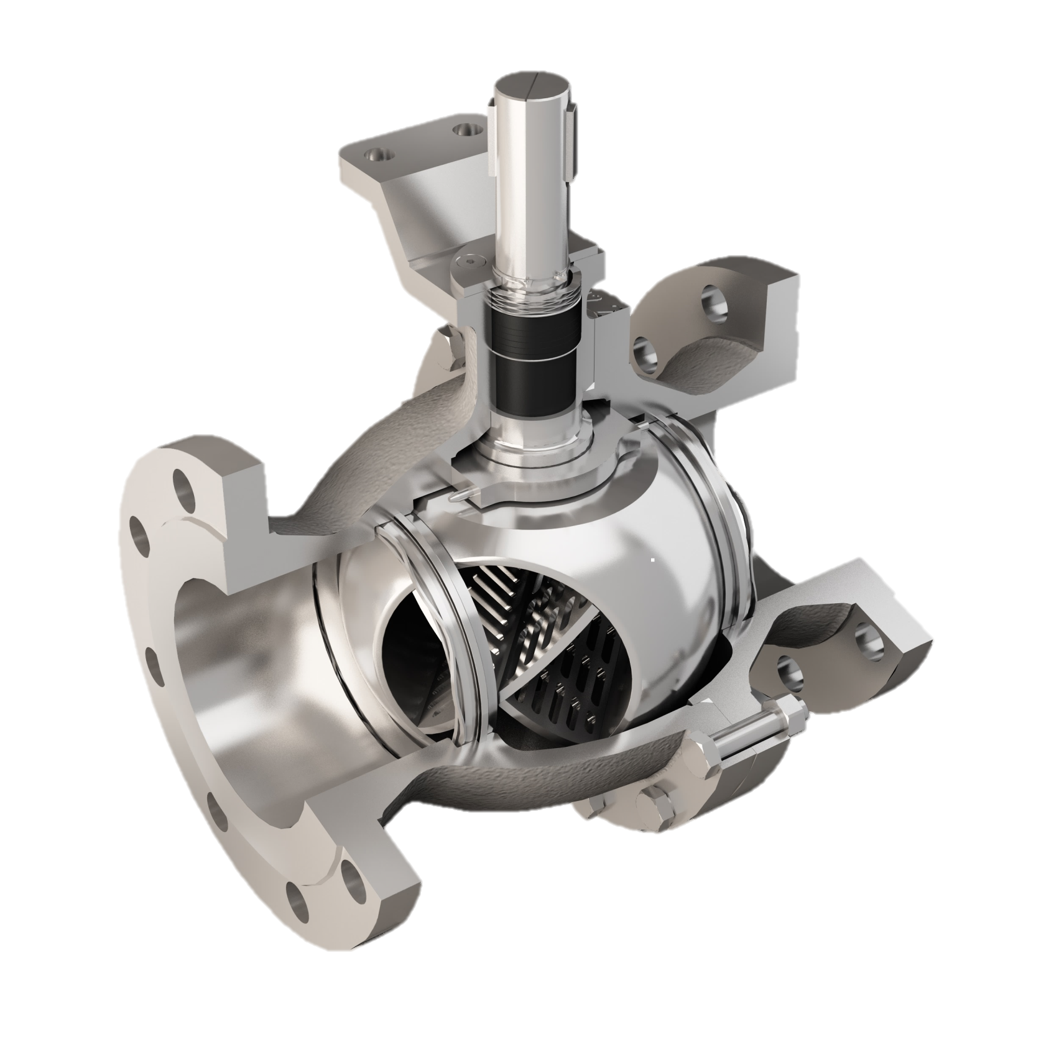
FLOWSERVE NAF
Trunnball DL Product Presentation

Slide 2
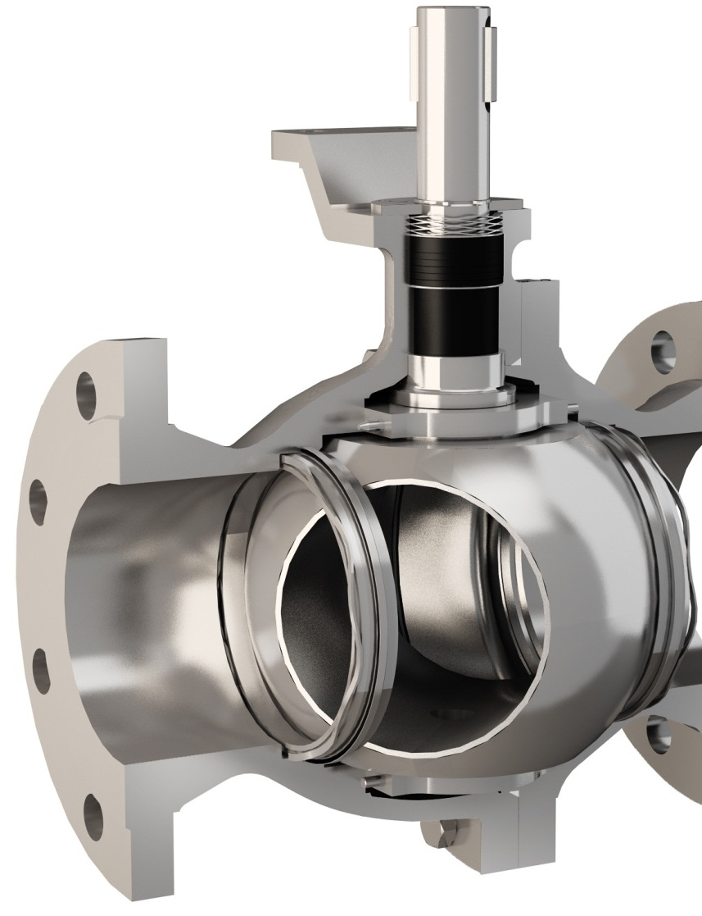
What is the NAF Trunnball DL?
High performance ball valve
Metal or soft seated
Full bore, two piece body
Trunnion mounted ball
Designed for both on-off and control applications

Slide 3
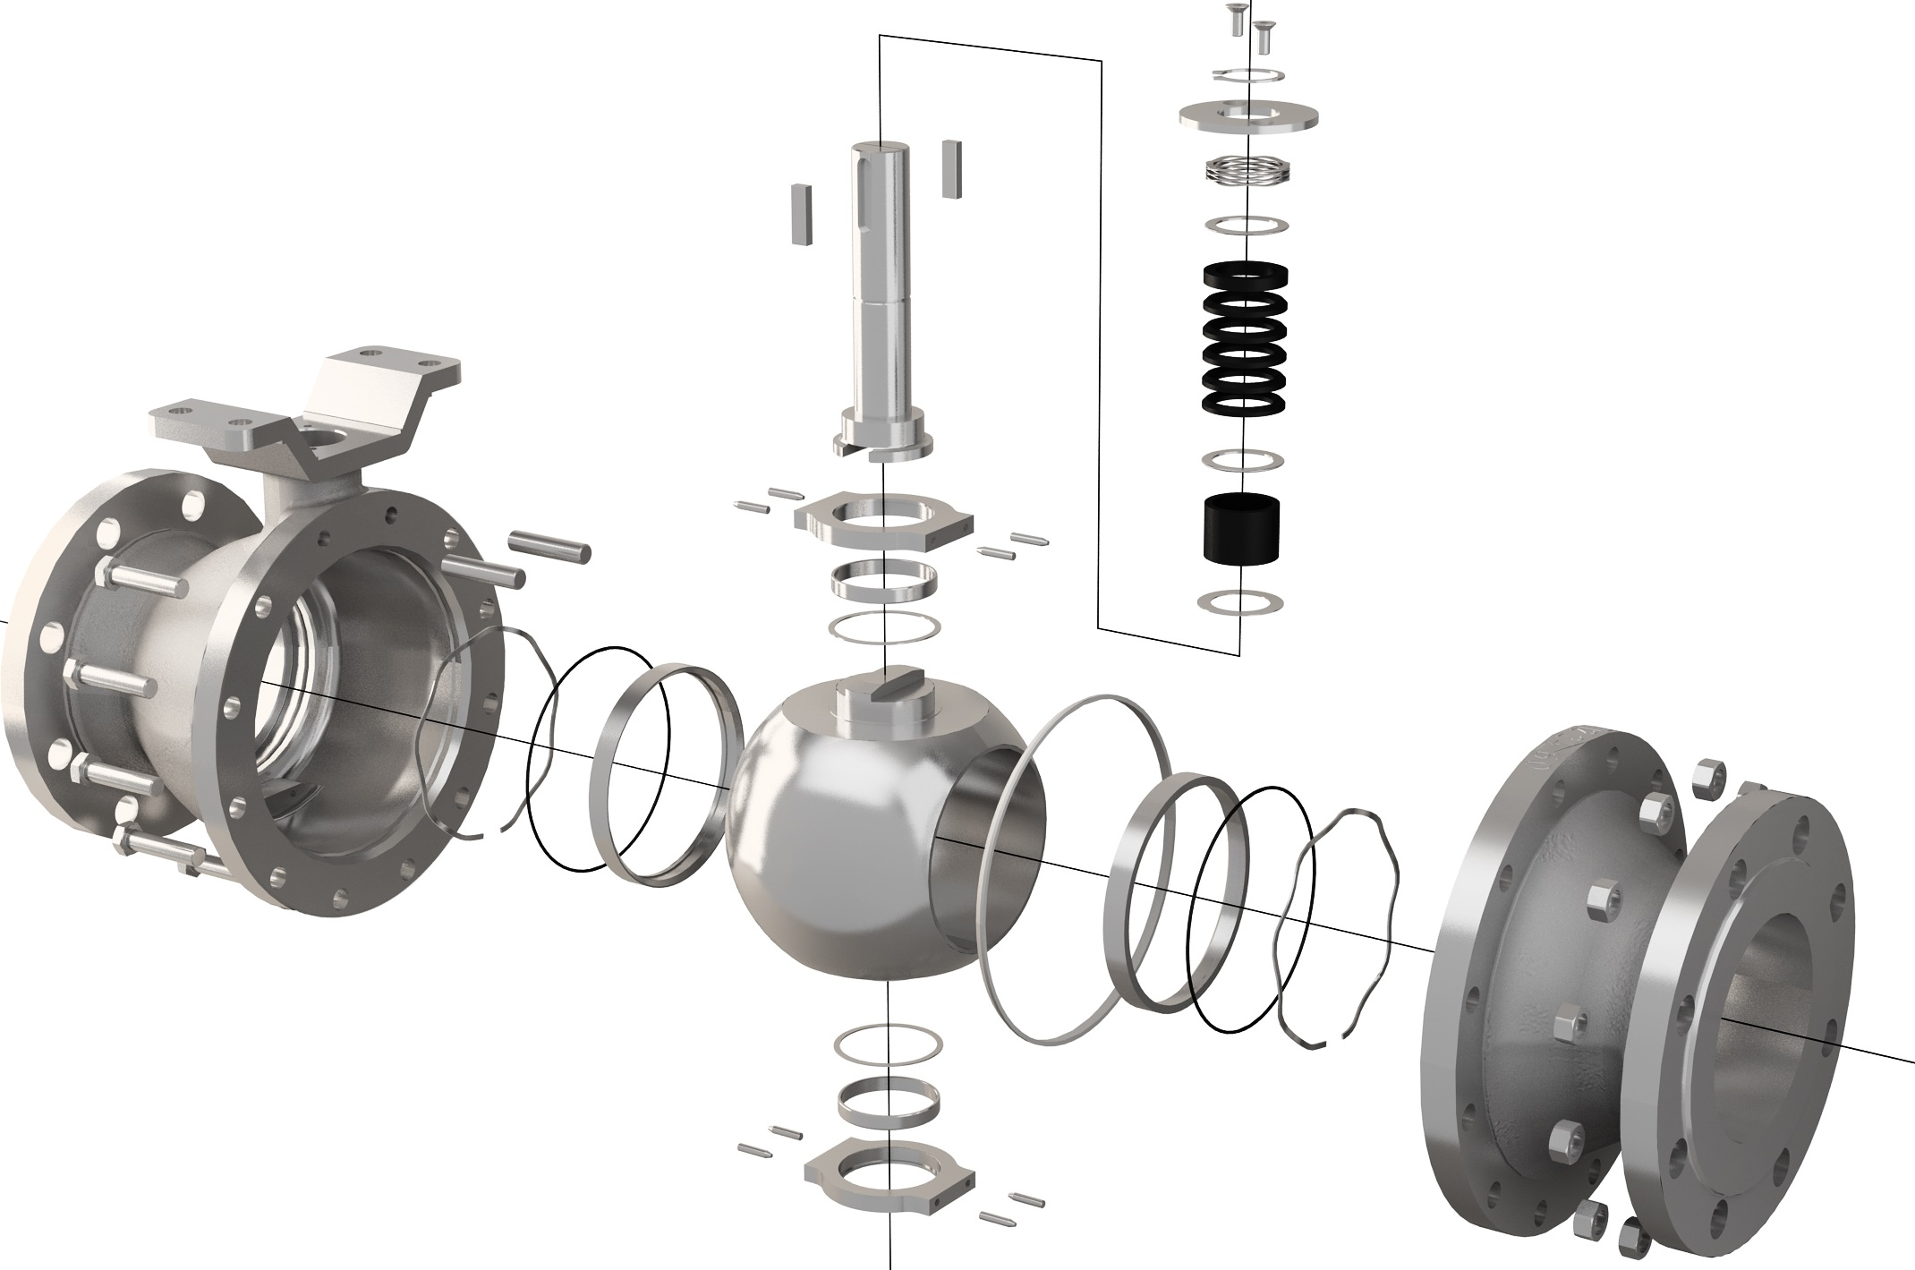
NAF Trunnball DL design
Blowout-proof stem providing a high torque transmission with a minimum mechanical backlash > Safe operation, better control performance
Spring loaded stem seal packing > Minimized risk for non-planned plant downtime and emissions to atmosphere
Up to 250°C/482°F in it’s standard configuration > Reduced inventory need due to the temperature coverage

Slide 4
NAF Trunnball DL design
Direct actuator mounting of the Turnex actuator which provides a high performance, vibration resistant, compact valve package > Lower maintenance cost, better control performance
Spring loaded metal seats with a rigid welded overlay of Alloy 6 or alternatively metal supported, reinforced PTFE seats > High tighness even at low differential pressures
Trunnion plates with large low friction bearings mounted inside the valve body> Minimized risk for external leakage and better control performance

Slide 5
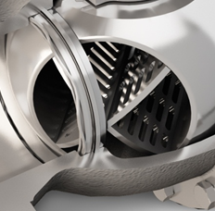
NAF Trunnball DL design
Unique Z-trim™ option that minimizes cavitation and noise and has an excellent control characteristic > Better working environment, lower maintenance cost for wear, better control performance

Slide 6
NAF Duball DL design
Blow out proof stem
Direct mounting
of Turnex
Spring loaded Stem Packing
(V-rings)
Two-piece Off-centre
Metal- or soft seated
Trunnion mounted Ball,
Standard or Z-trim
Low friction bearings

Slide 7
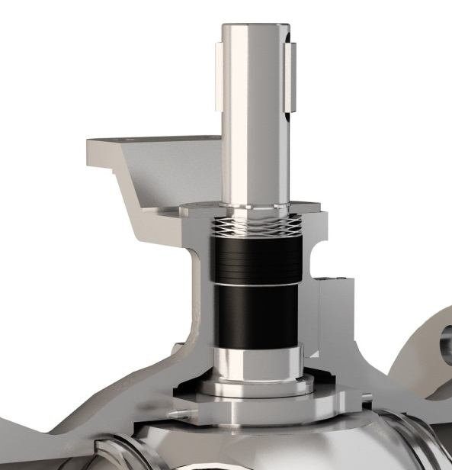
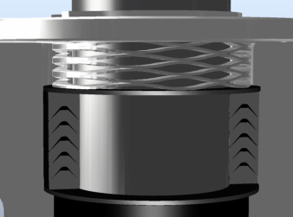
Spring loaded stem seal packing
Wave spring, preload > no need for manual re-tightening
R-PTFE V-rings >
multistage seal,
minimum risk for leakage
250°C/482°F as standard
High thrust, anti-friction washer > can take high pressure and high cycle applications

Slide 8
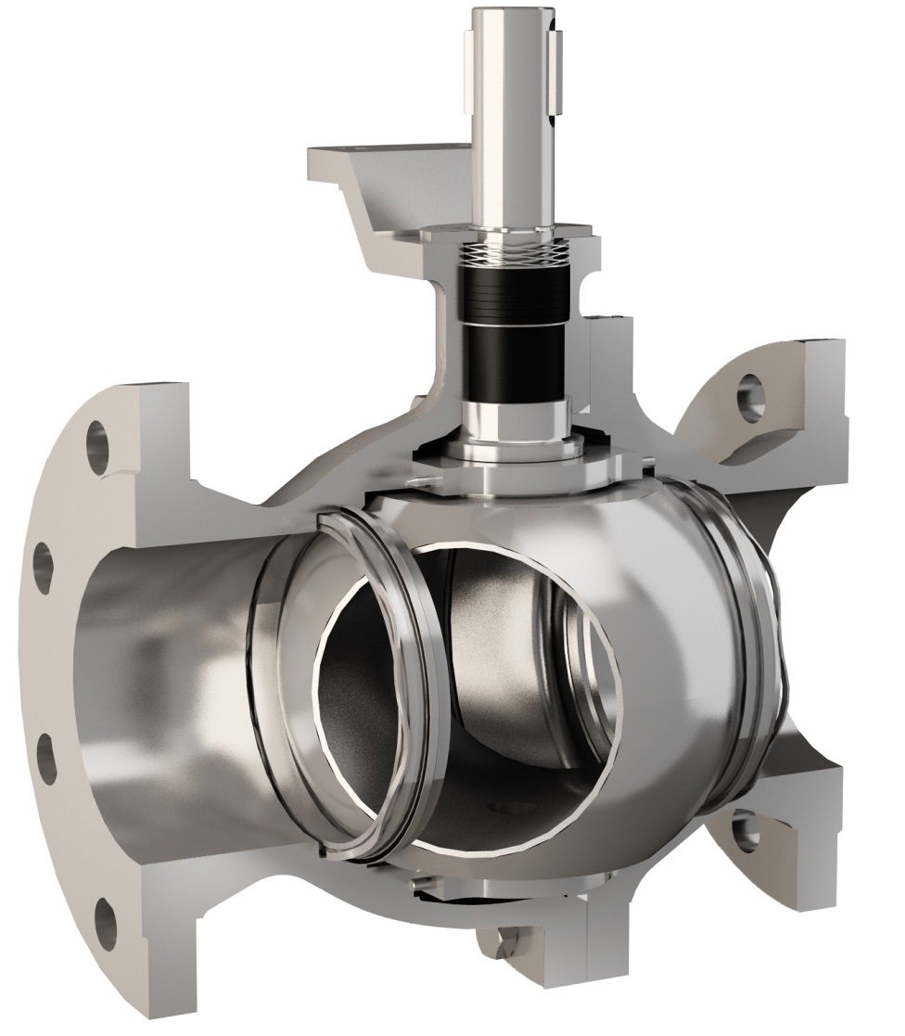
NAF Trunnball DL, standard seats

Slide 9
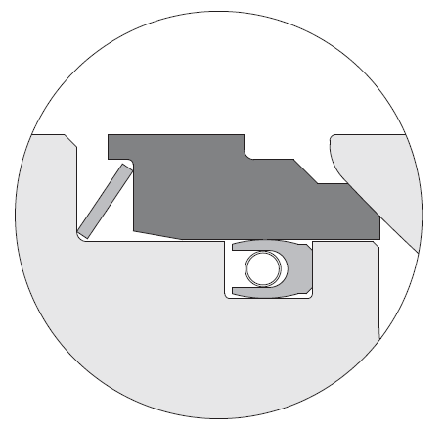
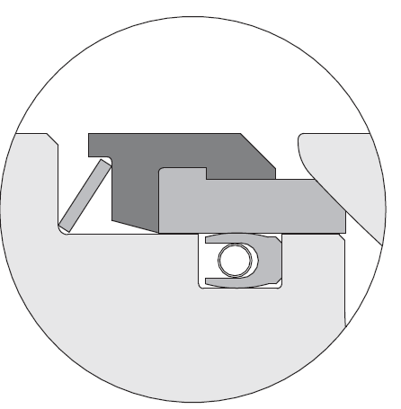
NAF Trunnball DL, standard seats
Both seat designs are very rugged and rigid > Minimized risk for non-planned plant downtime due to seat damage
Metal support ring > Prevents the soft seat from plastic deformation under load
Lip (part of the seat) > Eliminates the risk of spring being drawn into flow
Lip (part of the support ring) > Eliminates the risk of spring being drawn into flow
Spring
Support ring
Spring
Ball
Ball
Seat
Seat
Body
Body
Seal
Seal
Metal seat standard
Soft seat standard
Metal seats with a rigid welded overlay of Alloy 6 (min 2 mm)

Slide 10
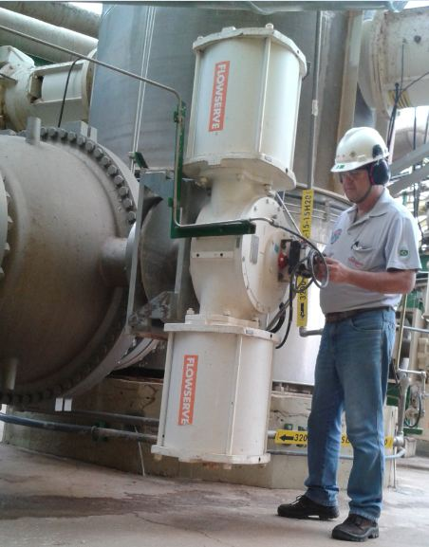
Trunnball DL, some typical applications
Pulp stock handling in fiberline (washing, oxygen delignification, screening, bleaching) in a pulp plant
General ball valve applications with higher differential pressures
Pressure control of low- and medium-pressure steam
Control applications where a high Cv is needed
Gas pressure control (with Z-trim)
High flow slurry and erosive medium applications
NAF Trunnball in oxygen delignification

Slide 11
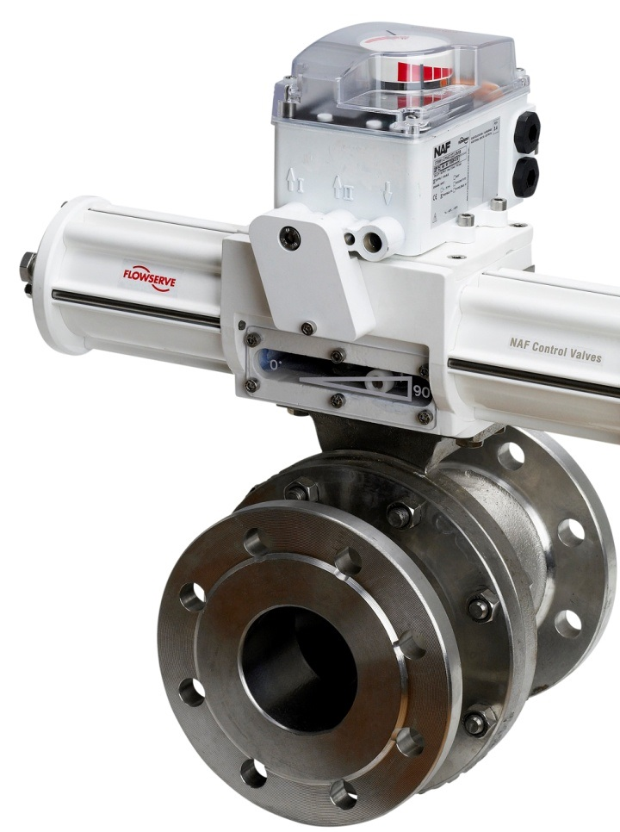
NAF Trunnball DL
Material: CF8M, WCB (Duplex, Hastelloy, Titanium etc.)
Sizes: DN150-DN900
ANSI 6” – 36” Full bore
Pressure class: PN10-PN40
ANSI Class 150 & 300
Tightness class: PTFE-seats: EN 12266-1:2012, rate A (ISO 5208, rate A)
Metal seats: EN 60534-4, Class V
ANSI FCI 70-2, Class V
Connection: Flanges
Temperature: -30 - 250°C
-22 - 482°F

Slide 12
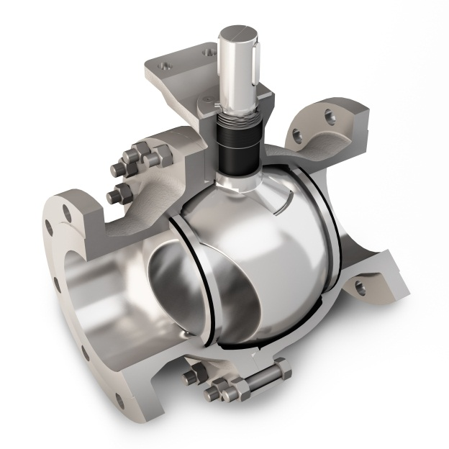
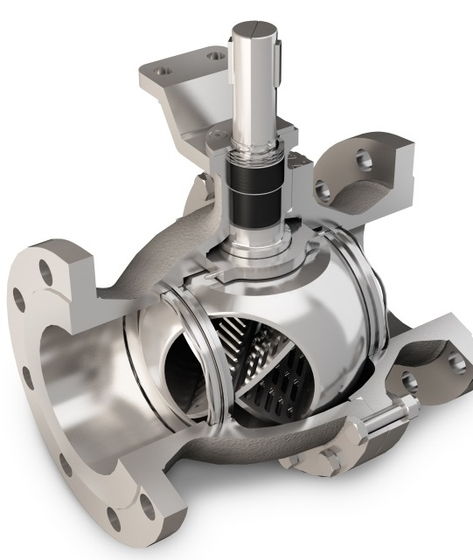
NAF Duball DL + NAF Trunnball DL
The complete range of NAF flanged full port ball valves
Maximum allowed dp
NAF Duball DL, floating ball
NAF Trunnball DL, trunnion mounted ball

Slide 13
Summary of features and benefits of
NAF Trunnball DL
State-of-the-art spring loaded stem seal packing that requires no maintenance and ensures safe operation in automated on-off and control service > Minimized risk for non-planned plant downtime and emissions to atmosphere
With the PTFE V-ring stem seal, the valve can take applications up to 250°C/482°F in it’s standard configuration > Minimized inventory need due to the temperature coverage
Direct actuator mounting capabilities of the Turnex actuator which provides a high performance, vibration resistant, compact valve package > Lower maintenance cost, better control performance
Sturdy, blowout-proof stem providing a high torque transmission with a minimum mechanical backlash > Safe operation, better control performance

Slide 14
Summary of features and benefits of
NAF Trunnball DL
Unique Z-trim™ option that minimizes cavitation and noise and has an excellent control characteristic > Better working environment, lower maintenance cost for wear, better control performance
An extensive size range, DN25/1”” up to DN900/32” together with NAF Duball DL > Cover the majority of ball valve applications in a plant
Easy-to-service arrangement, due to the off-center joint face of the valve body, which allows for easy replacement of the ball and seals, without the need for removing the stem and actuator > Minimized time for maintenance and plant downtime
Spring loaded metal seats with a rigid welded overlay of Alloy 6 or alternatively metal supported, reinforced PTFE seats > High tightness even at low differential pressures

Slide 15
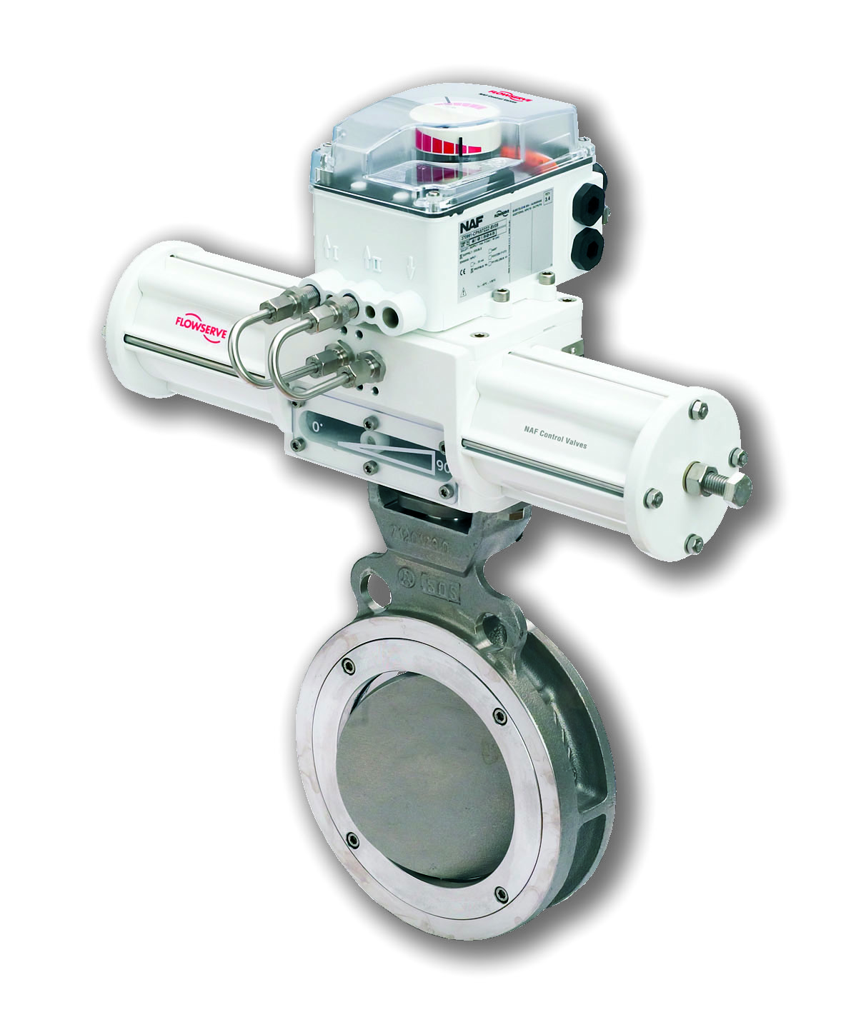
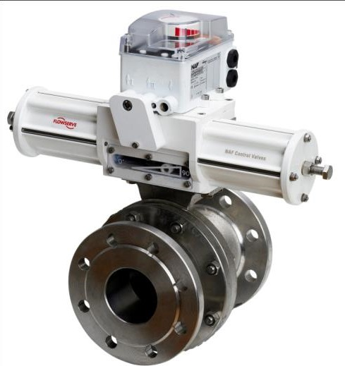
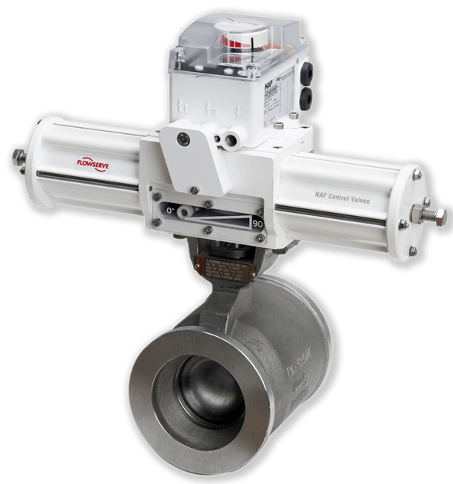
. . and our other rotary control valves . .
NAF Torex
High performance, triple offset butterfly valve
DN80/3”-DN700/28”, wafer&lug style
PN10-PN40/ANSI Class 150 and 300
NAF Duball DL
High performance, floating ball valve.
DN25/1”-DN400/16”
PN10-PN40/ANSI Class 150 and 300
NAF Setball
High performance, V-port, segmented ball valve
Wafer, Flanged, SF and MC-pulp versions
DN25/1”-DN500/20”
PN10-PN40/ANSI Class 150 and 300

Slide 16
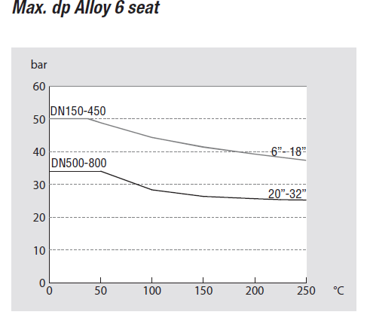
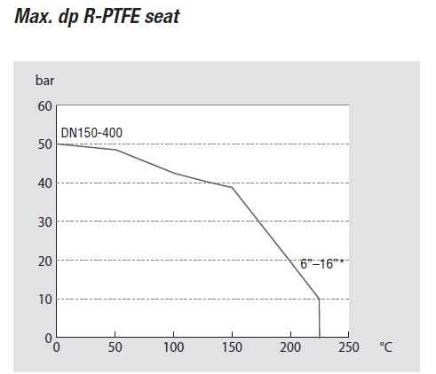
Appendix 1: Maximum allowed
differential pressure for Trunnball DL

Slide 17
Thank you for your attention

